Slide 1
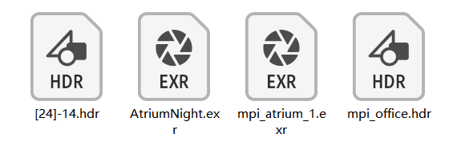
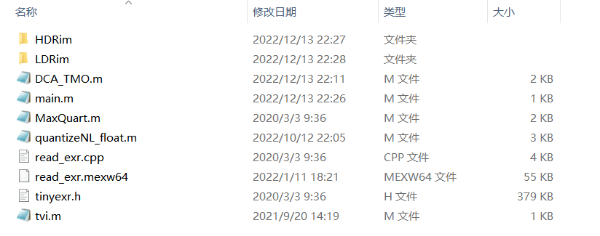
materials
main.m
The main function. It reads HDR images from the file folder HDRim as input, processes the input image by calling DCA_TMO.m function, and writes the tone-mapped image into the file folder LDRim.
DCA_TMO.m
MaxQuart.m quantizeNL_float.m
tvi.m

Slide 2
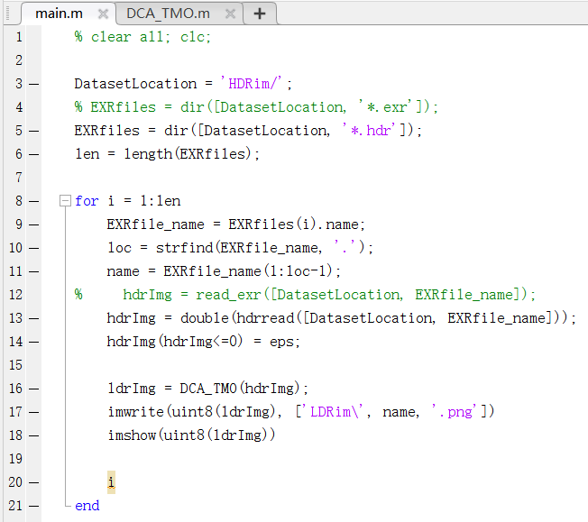
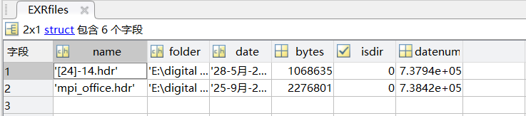
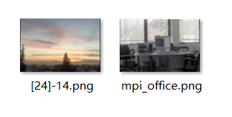
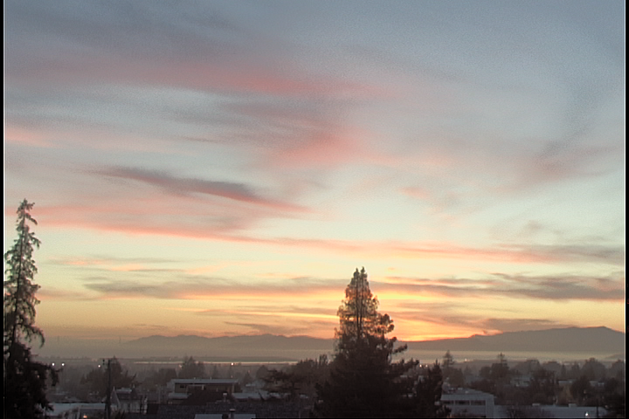
main.m

Slide 3
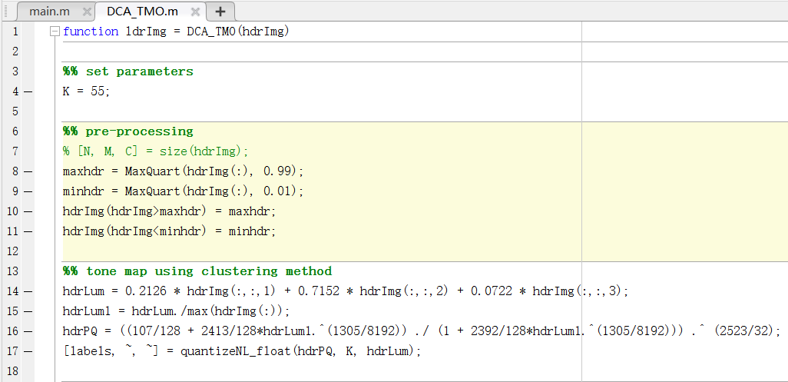
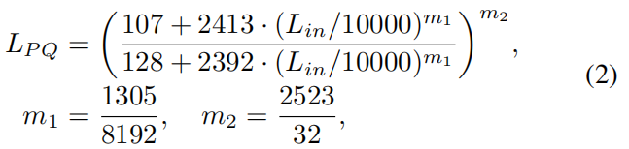
DCA_TMO.m
Line 8–11:
Cut off 1% of the brightest and 1% of the dimmest pixels of the input HDR image.
Line 14–16:
Compute luminance vaues and transform them into PQ domain.
Line 17:
Compute the tone-mapped luminance values based on a clustering scheme.

Slide 4
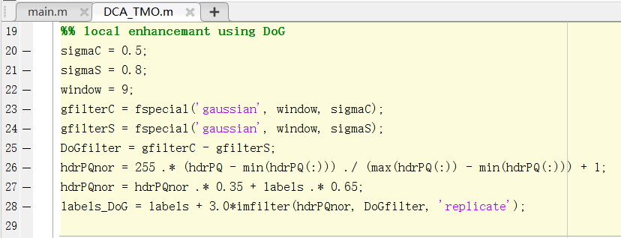


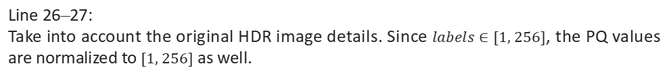
DCA_TMO.m
Line 20–25:
Construct a difference of Gaussians (DoG) filter.
Line 26–27:
Take into account the original HDR image details. Since $labels∈[1, 256]$, the PQ values are normalized to $[1, 256]$ as well.
Line 28:
Enhance details.

Slide 5
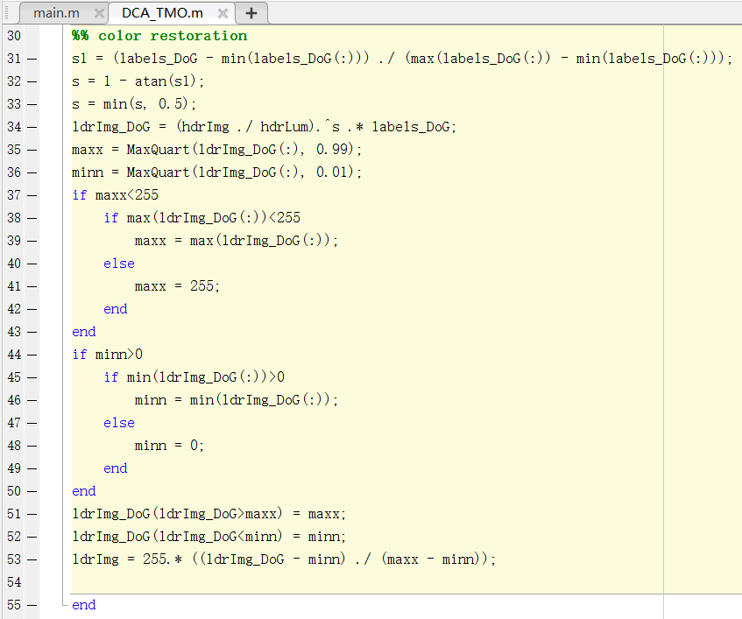

DCA_TMO.m
Line 31–34:
Restore colors.
Line 35–53:
Normalize the tone-mapped values to the range $[0, 255]$.

Slide 6
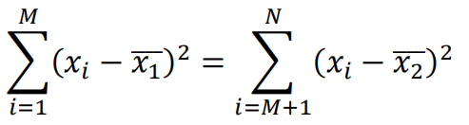









quantizeNL_float.m
N samples
$$e_{1}$$
$$e_{2}$$
$$x_{1}$$
$$x_{M}$$
$$x_{N}$$
step 1
$$e_{2}>e_{1}$$
step 2
$$x_{1}$$
$$x_{2}$$
$$x_{M}$$
$$x_{N}$$
...
...
...
...
...
step n
$$x_{1}$$
$$x_{2}$$
$$x_{M}$$
$$x_{N}$$

Slide 7
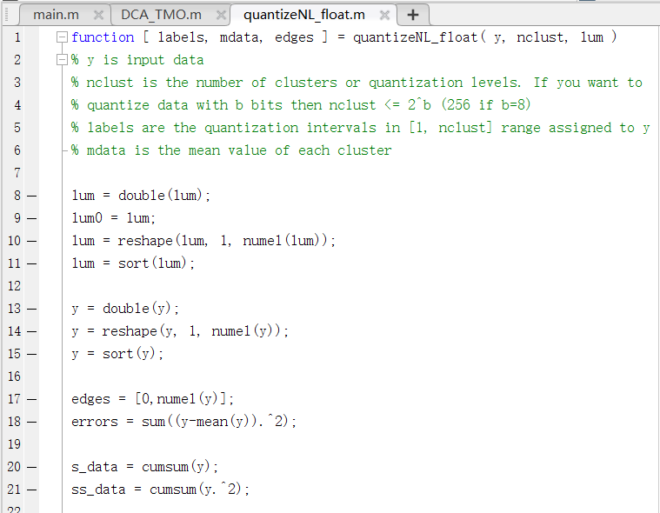
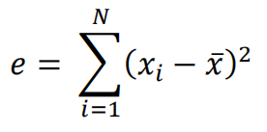
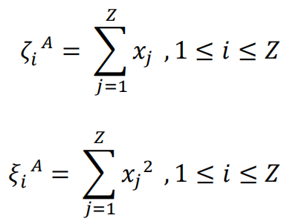
quantizeNL_float.m
Line 8–21:
Initial preparations.

Slide 8
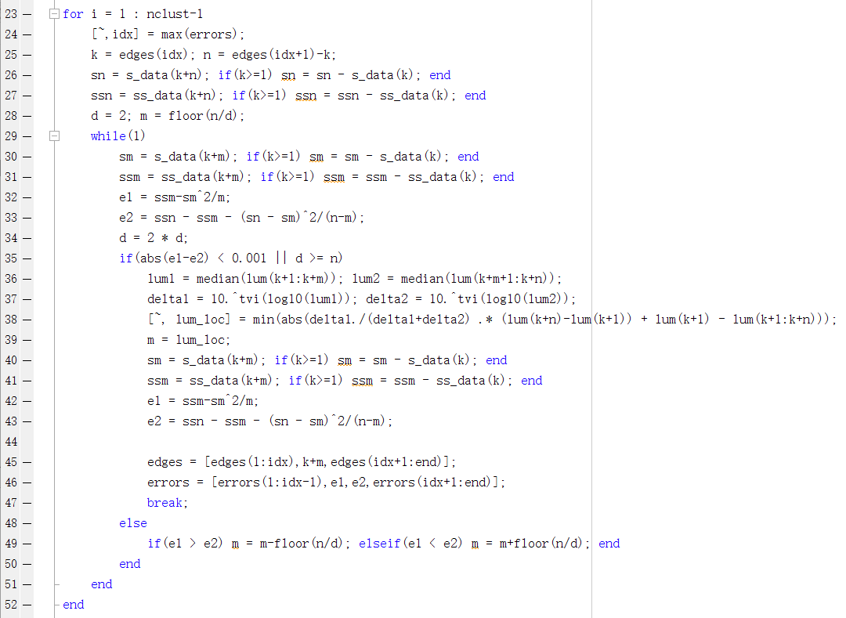
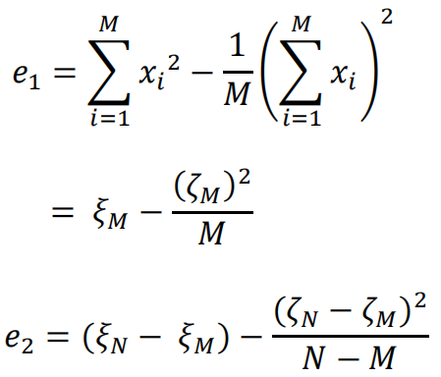

quantizeNL_float.m

Slide 9
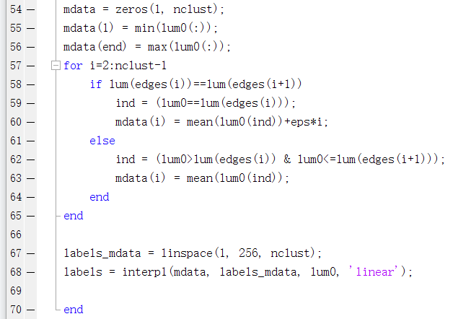


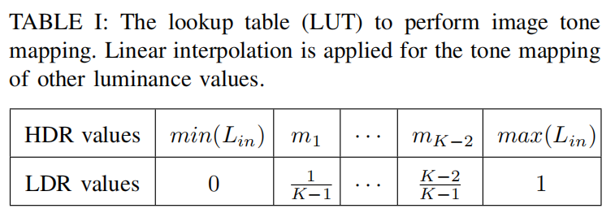
quantizeNL_float.m
Line 54–65:
Cluster input values into K groups and compute K means.
Line 67–68:
Now we have K means and their corresponding labels, we can compute other values’ labels based on a linear interpolation.

